Slide 1
Introduction to Probability
Year 7
Mathematics

Slide 2
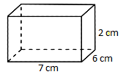
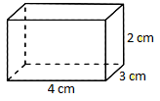
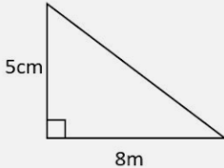
Review questions
1. Find the volume of the following image
2. Find the volume of the following image
3. Convert 1.75km to mm
4. Find the value of x, 2x + 2 = 12
5. find the area of this triangle

Slide 3
Topic: Probability
EQ – What is probability, and how do we use it?
What is probability?
Probability relates to the chance of something happening.
Some examples can include;
The chance of rain,
the chance of getting tail after flipping a coin,
The chance of getting 7 when rolling dice,
The chance a year 7 student will arrive on time.

Slide 4
Topic: Probability
EQ – What is probability, and how do we use it?
What are some key words relating to probability
Event - Something that may or may not happen,
Outcomes - Possible results of an event,
Chance — A possibility or likelihood,
Predictions - When you use the probability of an event to make an educated guess,
Certain - Some events are certain and know that they must happen.
Impossible - Some events are impossible, and you know that they can never happen,
Equally Likely - Outcomes that have the same chance of occurring.
More Likely - Greater chance that an event will happen.
Less Likely - Smaller chance that an event will happen.

Slide 5
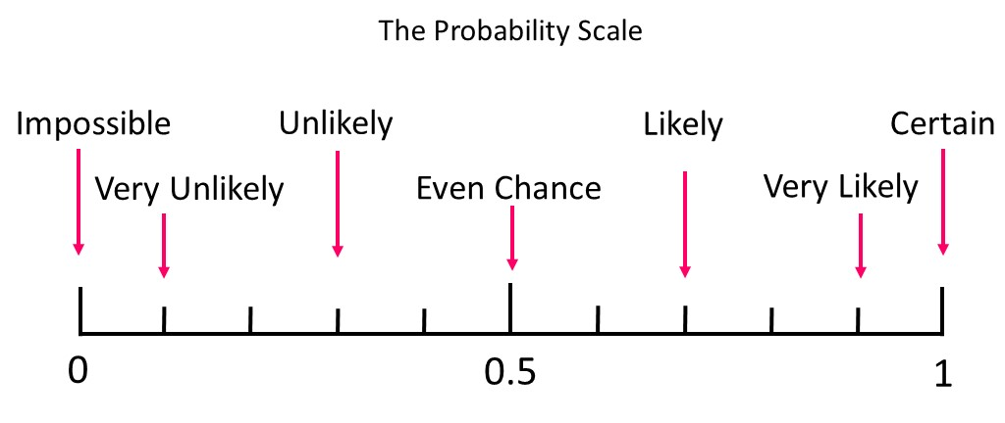
Topic: Probability
EQ – What is probability, and how do we use it?
How do we judge probability?
When judging probability, we use a probability scale, like the one shown below.
When something is impossible it has no ‘chance’ of occurring, while if something is certain, it will definitely happen.

Slide 6
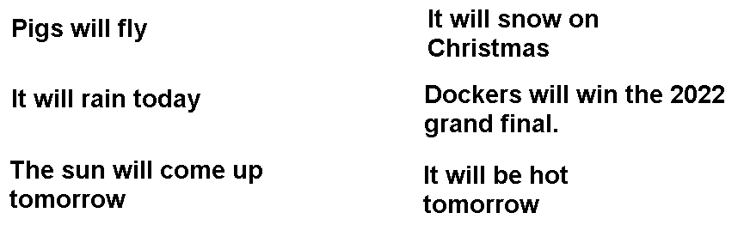
Topic: Probability
EQ – What is probability, and how do we use it?
How do we judge probability?
Using the below scale and the examples, choose when you think the events would be place on the below image

Slide 7
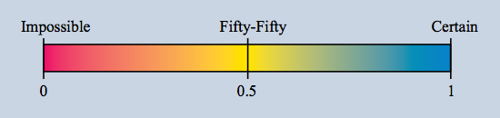
Topic: Probability
EQ – What is probability, and how do we use it?
Where would the following fit on the above probability
a) The day after Monday will be Tuesday.
b) Next year will have 390 days.
c) We will have a new Maths teacher next week.
^{d) I will watch TV tonight.}
e) I will become the Prime Minister.
f) I will drink some milk today.
^{g) It will rain tomorrow.}
h) I will get my driver's licence before I am 21.
i) When a coin is thrown it will land tails up.
j) I will send a text message today.
k) The next movie I watch will be an action movie.
l) The next person to walk through the door will be a girl.
Additional practice

Slide 8
Student questions
a) List 3 events in your everyday life that will be certain.
b) List 3 events in your everyday life that will be impossible.
c) List 3 events in your everyday life that will be approximately fifty-fifty.
d) The probability of tossing a coin and getting a head is fifty-fifty, or 0.5 or 1⁄2. If a coin is tossed 100 times, will the number of heads be 50?
e) The probability of rolling a die and getting a 6 is one-sixth, or 0.17, or 1/6. If a die is rolled 60 times, will the number of 6s be 10?
f) Almost every gambling game involving money is unfair.
g) We have Buckley's chance of winning the match.

Slide 9

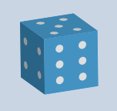

The Sample Space for spinning the spinner.
^{S = {Green, Blue, Red, Yellow}}
The Sample Space for throwing a die.
S = {1,2,3,4,5,6}
The Sample Space for tossing a coin.
S = {H,T}

Slide 10

Theoretical Probability—
The probability of an event
is the number of favourable outcomes divided by the number of possible outcomes.

Slide 11

Experimental Probability— probability based on the results of repeated trials of an experiment.
If the experiment is fair then with a large number of trials, the experimental probability and the theoretical probability should be similar.

Slide 12
Review quiz

Slide 13
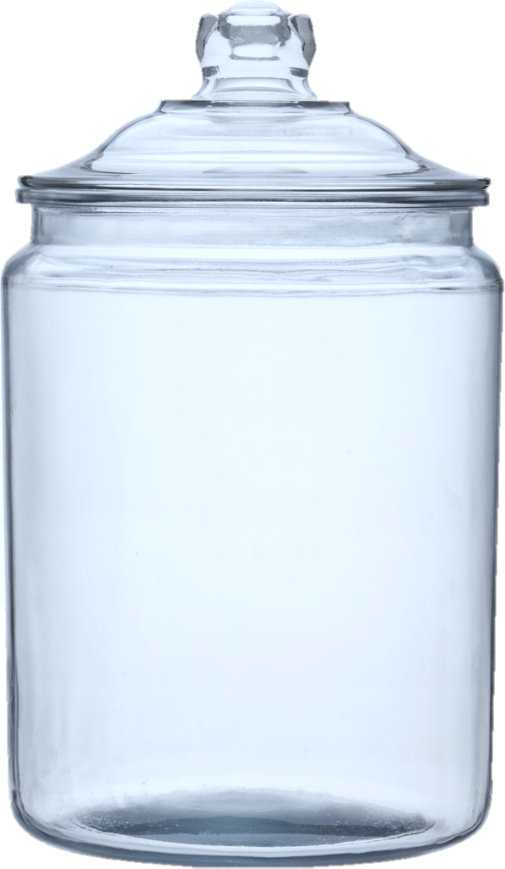
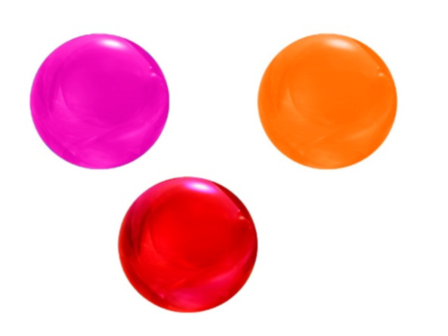
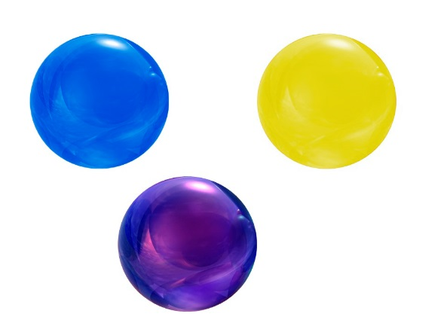

Fractions
Remember when writing a fraction.
The denominator is the top number, and the numerator is the bottom number.
Top Number
Bottom Number

Slide 14
Probability
What is the probability of choosing a red marble?
Remember to simplify
all fractions

Slide 15
Probability
What is the probability of choosing a blue marble?
Remember to simplify
all fractions

Slide 16
Probability
What is the probability of choosing a orange marble?
Remember to simplify
all fractions

Slide 17
Probability
What is the probability of choosing a black marble?
Remember to simplify
all fractions

